Slide 1

Advanced Python
Week 5

Slide 2

About Me
Kristen McIntyre
Machine Learning Engineer, Booz Allen Hamilton
Poster Committee Chair, Python Software Foundation
Core-Contributor, Scikit-Yellowbrick
Technical Reviewer, O’Reilly Media
Email: kam452@georgetown.edu
GitHub: github.com/Kautumn06

Slide 3


Slide 4


Slide 5

Databases
Efficient storage
Speedy retrieval
Reliability
ACID Principle
Atomicity: Transactions are indivisible
Consistency: Preserve valid state between transactions
Isolation: Concurrent vs serial transactions make no difference
Durability: Permanent storage once a transaction is committed

Slide 6
THEORY
1970 –
E. F. Codd. 1970. A relational model of data for large shared data banks. Commun. ACM 13, 6 (June 1970), 377–387. DOI:https://doi.org/10.1145/362384.362685
1987 –
"ISO 9075:1987: Information technology – Database languages – SQL – Part 1: Framework (SQL/Framework)". 1987-06-01.
IMPLEMENTAT
ION
1979 – Oracle
1989 – Microsoft SQL Server
1995 – MySQL
1996 – PostgreSQL
2000 – SQLite
2009 – MariaDB
2009 – AWS RDS
Notes:
E. F. Codd. 1970. A relational model of data for large shared data banks. Commun. ACM 13, 6 (June 1970), 377–387. DOI:https://doi.org/10.1145/362384.362685
SQLite is a single file-based and ships on all versions of Python.

Slide 7
Fundamental Concepts

Slide 8
Concepts
field
field
field
field
Tables are 2-D data structures that represent entities
Use a collective name
Only use letters, numbers, and underscores in names
Ex. Employee, Order, Student
Columns (“Fields”) represent attributes of the entities
Recommend using lowercase, singular names
Ex. name, title, salary, hired_date
Rows (“Records”) are single instances of an entity with values for fields
Ex. Barbara, CEO, $1,000,000, 1/1/2015
Cells are individual data points with coordinates by row and column
name | title | salary | hired_date
Barbara | CEO | $ 1,000,000 | 2014-01-01
Bob | CDO | $ 500,000 | 2015-05-01
row
row
cell

Slide 9
Concepts: data types
Type | Description
INTEGER | Whole numbers
REAL | A floating-point value (decimal)
TEXT | A text string, typically UTF-8 encoded (depending on the database encoding)
NULL | A NULL value, representing missing data or an empty cell
BLOB | A blob of data (binary large object) for storing binary data

Slide 10
Data Types: numeric
Type | Signed Range | Unsigned Range
TINYINT | −128 to 127 | 0 to 255
INT, INTEGER | −2,147,483,648 to 2,147,483,647 | 0 to 4,294,967,295
BIGINT | −2^63 to 2^63 - 1 | 0 to 2^64 - 1
Type | Example | Example Output
FLOAT | FLOAT(4,2) | -10.87
DECIMAL | DECIMAL(P,D)
BOOL, BOOLEAN | true, false | 1, 0, 1, 0,

Slide 11
Concept: primary key
name | title | salary | hired_date
Barbara | CEO | $ 1,000,000 | 2014-01-01
Bob | CDO | $ 500,000 | 2015-05-01
dept_name | dept_head | no_employees | tel_extension
Operations | Barbara | 20 | 101
Data | Bob | 5 | 102

Slide 12
Concept: primary key
name | title | salary | hired_date
Barbara | CEO | $1,000,000 | 2014-01-01
Bob | CDO | $500,000 | 2015-05-01
Barbara | Sales Rep | $80,000 | 2016-04-15
dept_name | dept_head | no_employees | tel_extension
Operations | Barbara | 20 | 101
Data | Bob | 5 | 102

Slide 13
Concept: composite primary key
name | title | salary | hired_date
Barbara | CEO | $1,000,000 | 2014-01-01
Bob | CDO | $500,000 | 2015-05-01
Barbara | Sales Rep | $80,000 | 2016-04-15
dept_name | dept_head | no_employees | tel_extension
Operations | Barbara | 20 | 101
Data | Bob | 5 | 102

Slide 14
Concept: auto-incrementing primary key
id | name | title | salary | hired_date
1 | Barbara | CEO | $1,000,000 | 2014-01-01
2 | Bob | CDO | $500,000 | 2015-05-01
3 | Barbara | Sales Rep | $80,000 | 2016-04-15
id | dept_name | dept_head | no_employees | tel_extension
1 | Operations | Barbara | 20 | 101
2 | Data | Bob | 5 | 102

Slide 15

Primary Key Considerations
The primary key should be simple.
The value of the primary key should not change since it is used to reference other tables in the database.
Use a non-negative integer (or other numeric type) rather than text for efficiency.
The primary key should take an arbitrary number.

Slide 16
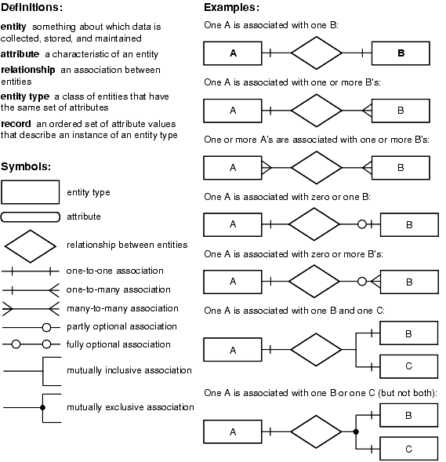
Concepts: relationships
One of the main benefits of relational databases is support for explicitly defining the relationships between entities:
Employees may relate to departments
Orders may relate to customers
Pets may relate to owners
Metro trains may relate to tracks
Shopping carts may be related to users
Relationships can be visualized using an “Entity Relationship Diagram” (ERD).

Slide 17
Relationships without Primary Keys
name | title | salary | hired_date
Barbara | CEO | $1,000,000 | 2014-01-01
Bob | CDO | $500,000 | 2015-05-01
Barbara | Sales Rep | $80,000 | 2016-04-15
dept_name | dept_head | no_employees | tel_extension
Operations | Barbara | 20 | 101
Data | Bob | 5 | 102

Slide 18
Concepts: foreign keys
Employee
id | name | title | salary | hired_date
1 | Barbara | CEO | 1000000 | 2014-01-01
2 | Bob | CDO | 500000 | 2015-05-01
3 | Barbara | Sales Rep | 80000 | 2016-04-15
Department
id | dept_name | dept_head | no_of_employees | tel_ex
1 | Operations | Barbara | 20 | 101
2 | Data | Bob | 5 | 102

Slide 19
Concepts: foreign keys
Employee
id | name | title | salary | hired_date
1 | Barbara | CEO | 1000000 | 2014-01-01
2 | Bob | CDO | 500000 | 2015-05-01
3 | Barbara | Sales Rep | 80000 | 2016-04-15
Department
id | dept_name | dept_head | no_of_employees | tel_ex
1 | Operations | 1 | 20 | 101
2 | Data | 2 | 5 | 102

Slide 20
Concepts: data types
Values can be of different data types, but all the values in the same column must be the same data type.
Data types bind values by what types of operations can be performed on them:
100 + 100 = 200 (INT)
100 + 100 = 100100 (TEXT)
name | title | salary | hired_date
Barbara | CEO | $ 1,000,000 | 2014-01-01
Bob | CDO | $ 500,000 | 2015-05-01

Slide 21
Entity Relationship Diagrams (ERD)

Slide 22


Concepts: one-to-one relationships
Each Department has a Department Head
Each Employee can be Head of one Department
Barbara (CEO) is in charge of the Operations department and ONLY the Operations department
id | name | title | salary | hired_date
1 | Barbara | CEO | 1000000 | 2014-01-01
2 | Bob | CDO | 500000 | 2015-05-01
3 | Barbara | Sales Rep | 80000 | 2016-04-15
id | dept_name | dept_head | no_employees | tel_ex
1 | Operations | 1 | 20 | 101
2 | Data | 2 | 5 | 102

Slide 23
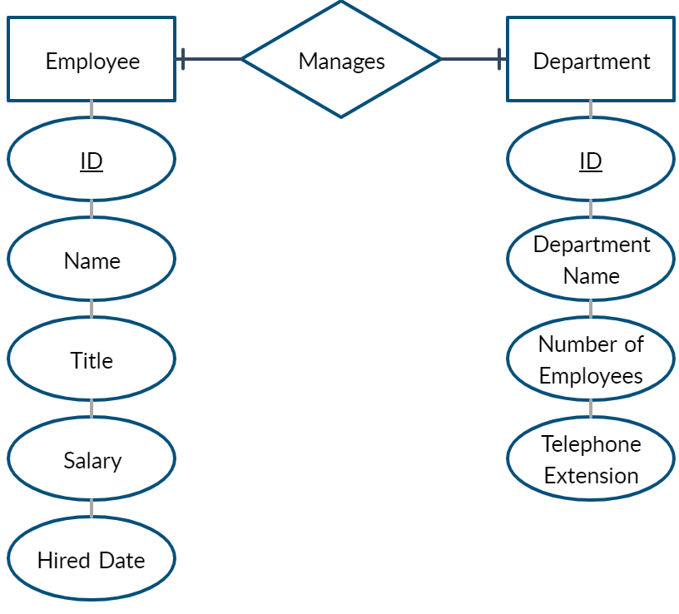
One-to-One Relationships

Slide 24
Concepts: one-to-many relationships
Each Department has a Department Head
Each Employee can be Head of more than one Department
Barbara (CEO) is in charge of the Operations department and the Data department
id | name | title | salary | hired_date
1 | Barbara | CEO | 1000000 | 2014-01-01
2 | Bob | CDO | 500000 | 2015-05-01
3 | Barbara | Sales Rep | 80000 | 2016-04-15
id | dept_name | dept_head | no_employees | tel_ex
1 | Operations | 1 | 20 | 101
2 | Data | 1 | 5 | 102

Slide 25

One-to-Many Relationships

Slide 26

Concepts: many-to-many relationships
Each Department has a Department Head
Each Employee can be Head of more than one Department
Barbara (CEO) and Bob are both in charge of the Operations department and the Data department

Slide 27
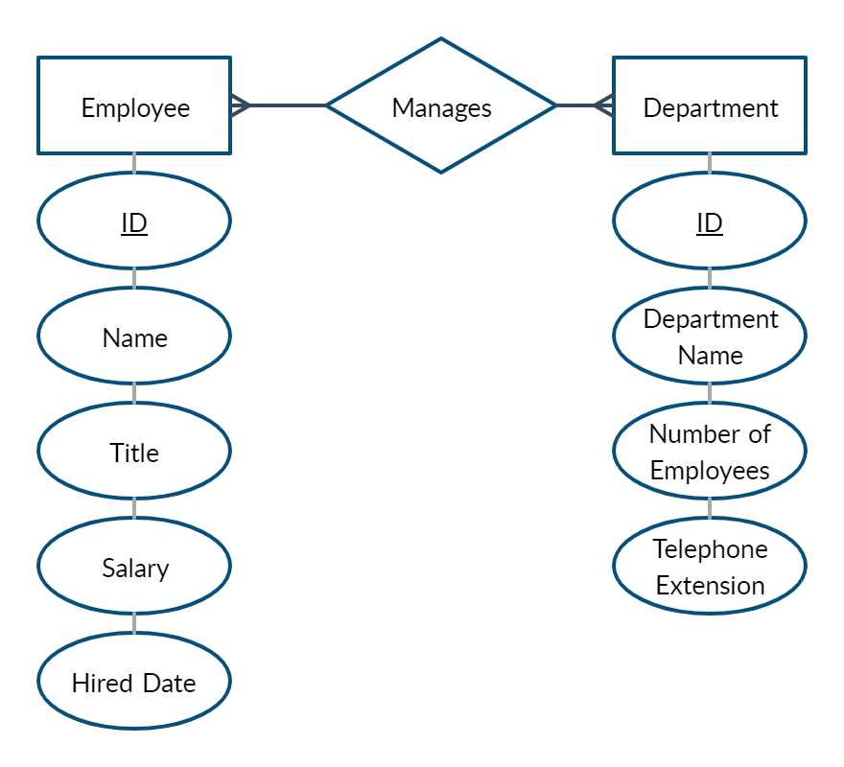
Many-to-Many Relationships

Slide 28
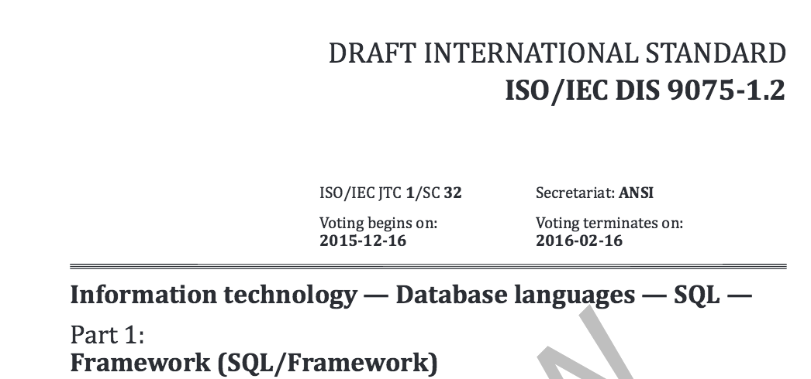
SQL as a standard
Structured Query Language, or SQL, is the language we write to interface with relational database management system (RDBMS) to manage and query data.
SQL is an international standard, but each RDBMS implements it a little differently and may or may not be feature complete to the standard.

Slide 29
SQL Commands
Data Query Language (DQL)
Examples include, SELECT
Data Manipulation Language (DML)
Examples include, INSERT, UPDATE, DELETE
Data Definition Language (DDL)
Examples include, CREATE, ALTER, DROP
Data Control Language (DCL)
Examples include, GRANT and REVOKE

Slide 30
Fun with JOINs!

Slide 31
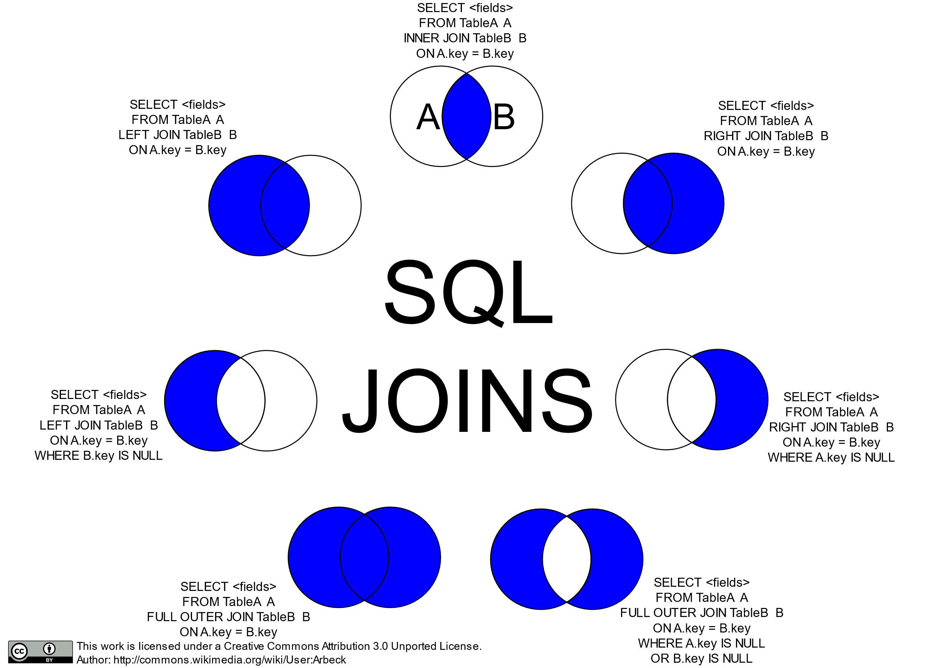

Slide 32
INNER Joins
Employee
id | name | title | salary | hired_date
1 | Barbara | CEO | 1000000 | 2014-01-01
2 | Bob | CDO | 500000 | 2015-05-01
3 | Barbara | Sales Rep | 80000 | 2016-04-15
Department
id | name | dept_head | no_of_employees | tel_ext
1 | Operations | 1 | 20 | 100
2 | Data | 2 | 5 | 101

Slide 33
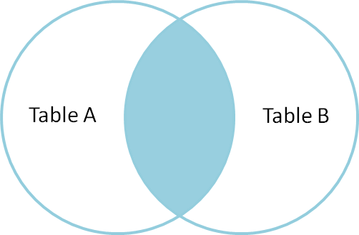
INNER JOIN
Notes:
The INNER JOIN clause includes only rows whose values match.
The JOIN clause follows the FROM clause.
The ON clause names a JOIN condition in how the tables are linked on a matching row.

Slide 34
SELECT column_name(s)
FROM tableA
INNER JOIN tableB
ON tableA.primary_key_col = tableB.foreign_key_col;
SELECT *
FROM employee
INNER JOIN department
ON employee.id = department.dept_head;
id | name | title | salary | hired_date | id | dept_name | dept_head | no_employees | tel_ext
1 | Barbara | CEO | 1000000 | 2014-01-01 | 1 | Operations | 1 | 20 | 100
2 | Bob | CDO | 500000 | 2015-05-01 | 2 | Data | 2 | 5 | 101
Notes:
By using SELECT *, the all of the columns from both tables are returned, with TableA’s columns coming first.
In this example, we want to return only those rows where the primary key in the Employee table matches the foreign key (“dept_head”) in the Department table.

Slide 35
SELECT column_name(s)
FROM tableA
INNER JOIN tableB
ON tableA.column = tableB.column;
SELECT *
FROM department
INNER JOIN employee
ON department.dept_head = employee.id;
id | dept_name | dept_head | no_employees | tel_ext | id | name | title | salary | hired_date
1 | Operations | 1 | 20 | 100 | 1 | Barbara | CEO | 1000000 | 2014-01-01
2 | Data | 2 | 5 | 101 | 2 | Bob | CDO | 500000 | 2015-05-01

Slide 36
SELECT Specific Columns
SELECT
employee.id,
department.dept_head,
department.dept_name,
employee.name
FROM employee
INNER JOIN department
ON employee.id = department.dept_head;
id | dept_head | dept_name | name
1 | 1 | Operations | Barbara
2 | 2 | Data | Bob

Slide 37
INNER Joins
Employee
id | name | title | salary | hired_date
1 | Barbara | CEO | 1000000 | 2014-01-01
2 | Bob | CDO | 500000 | 2015-05-01
3 | Barbara | Sales Rep | 80000 | 2016-04-15
Department
id | name | dept_head | no_of_employees | tel_ext
1 | Operations | 1 | 20 | 100
2 | Data | 2 | 5 | 101

Slide 38
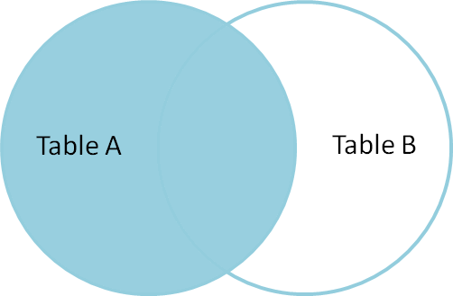
LEFT OUTER JOIN
Notes:
The LEFT OUTER JOIN returns all the records from Table A, and only those from Table B that match the JOIN condition.

Slide 39
Left outer Joins
SELECT <fields>
FROM tableA
LEFT JOIN tableB
ON tableA.column = tableB.column;
SELECT
employee.id,
employee.name
department.id,
department.dept_name,
FROM employee
LEFT JOIN department
ON employee.id = department.dept_head;
id | name | id | dept_name
1 | Barbara | 1 | Operations
2 | Bob | 2 | Data
3 | Barbara | NULL | NULL

Slide 40
Left outer Joins
SELECT <fields>
FROM tableA
LEFT JOIN tableB
ON tableA.column = tableB.column;
SELECT
employee.id,
employee.name,
department.id,
department.dept_name
FROM department
LEFT JOIN employee
ON department.dept_head = employee.id;
id | name | id | dept_name
1 | Barbara | 1 | Operations
2 | Bob | 2 | Data

